Slide 1

MARKET BASKET ANALYSIS
Aditya Rishi
PGP_DSBA Feb-21
MRA Milestone 2 project

Slide 2
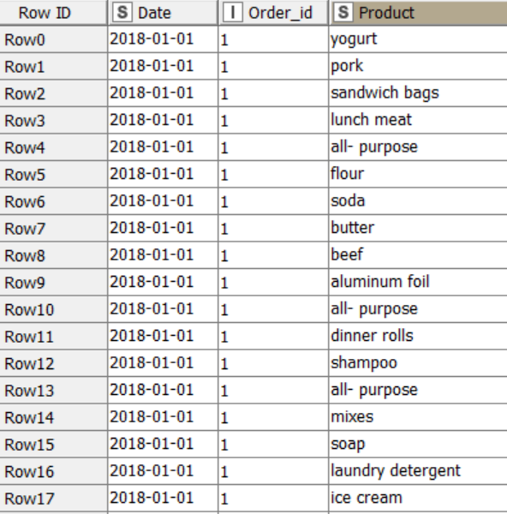
3
Features: - Date, Order Id, Product
Date
Multistring date, covers 2018, 2019, 2 months of 2020
Order Id
Numeric, counts orders placed
Product
Categorical list of store items
DATASET AT A GLANCE

Slide 3
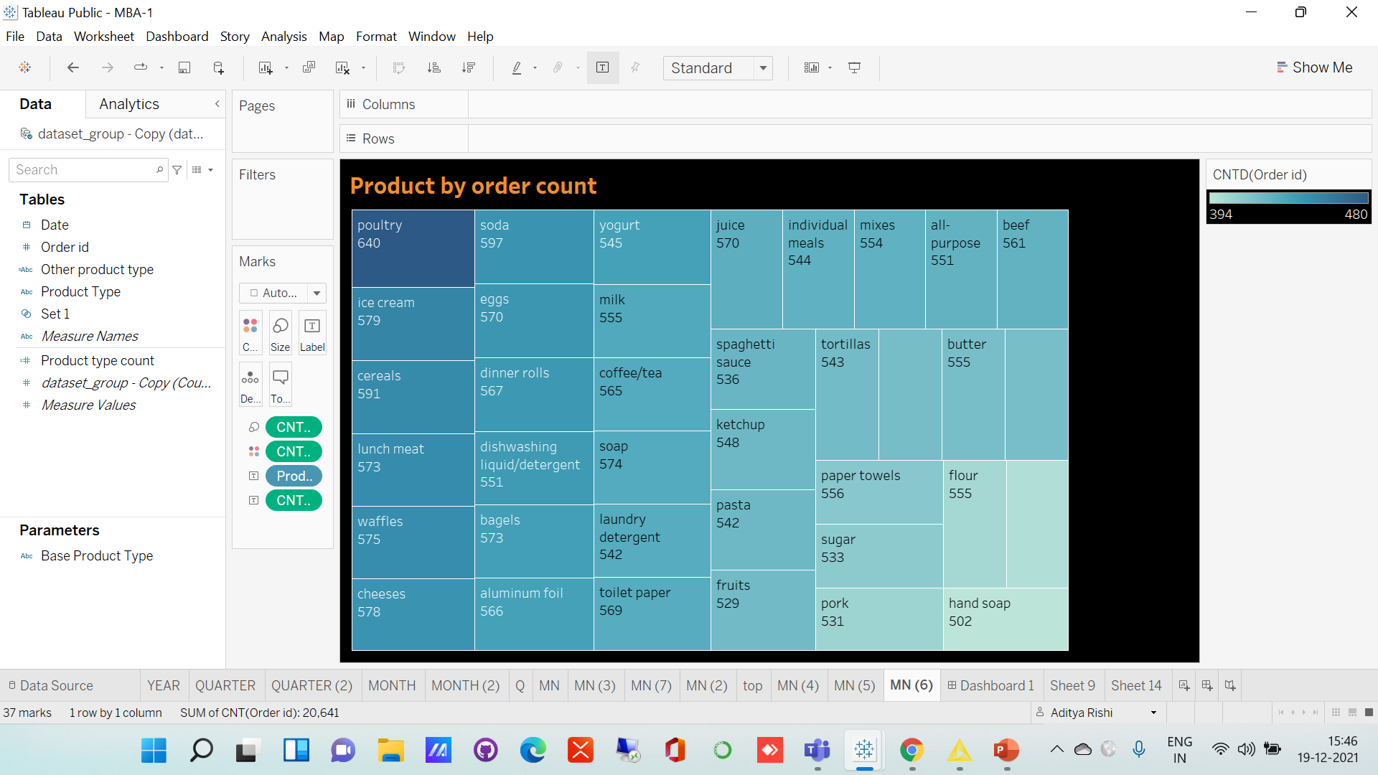
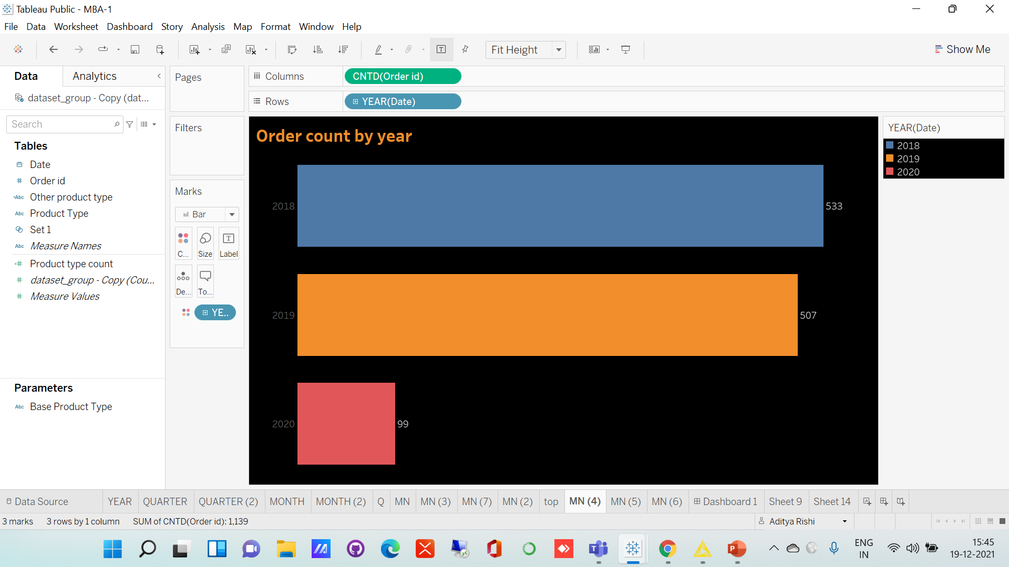
Hand soap
Least ordered
EXPLORATORY DATA ANALYSIS
Poultry
Most ordered
Ice-cream
Second most popular
2018
Better of the two full years

Slide 4
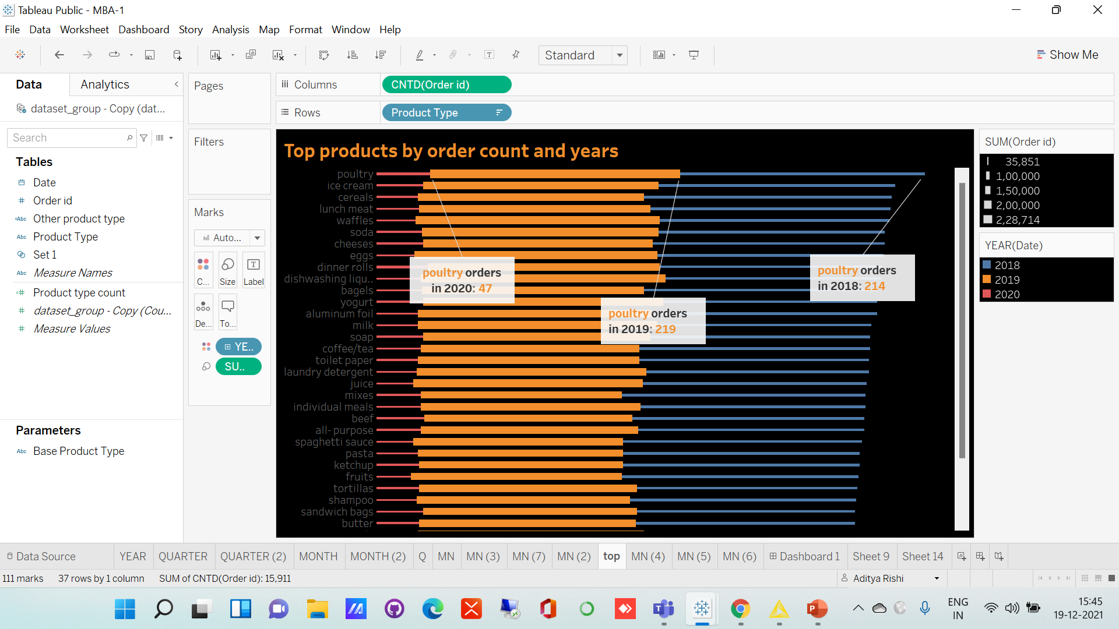
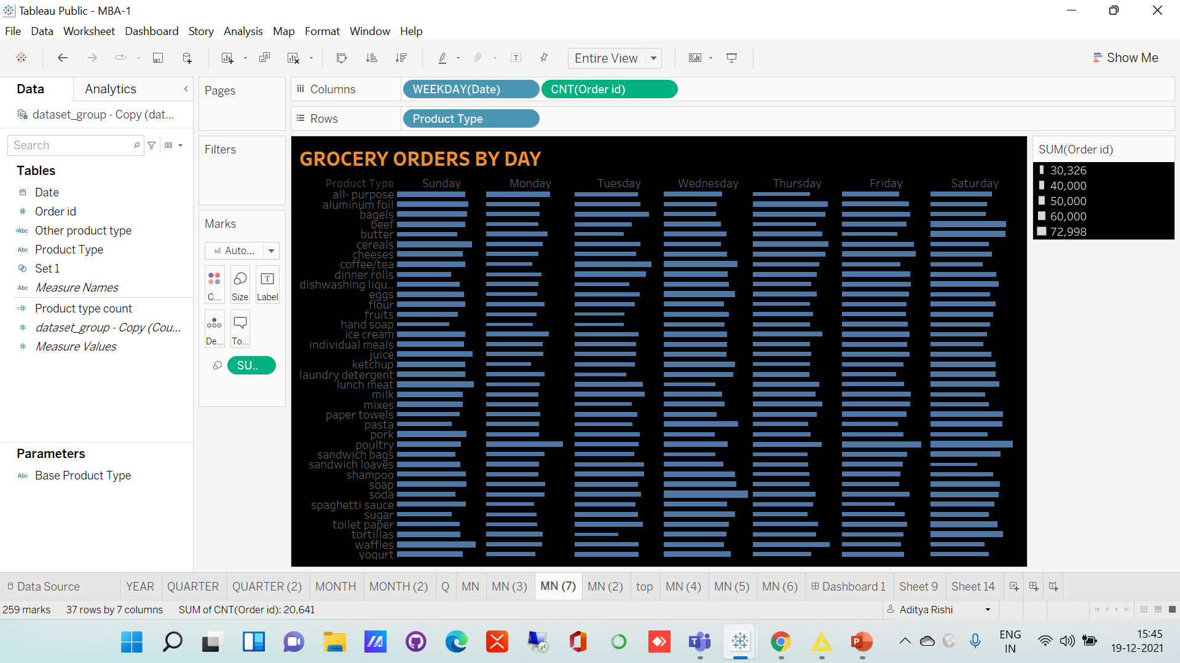
Close
Most order counts
EXPLORATORY DATA ANALYSIS
Poultry
Ordered most in 2019
Mondays
Lean days
Sundays
Packed. Cereals, pork sell more

Slide 5
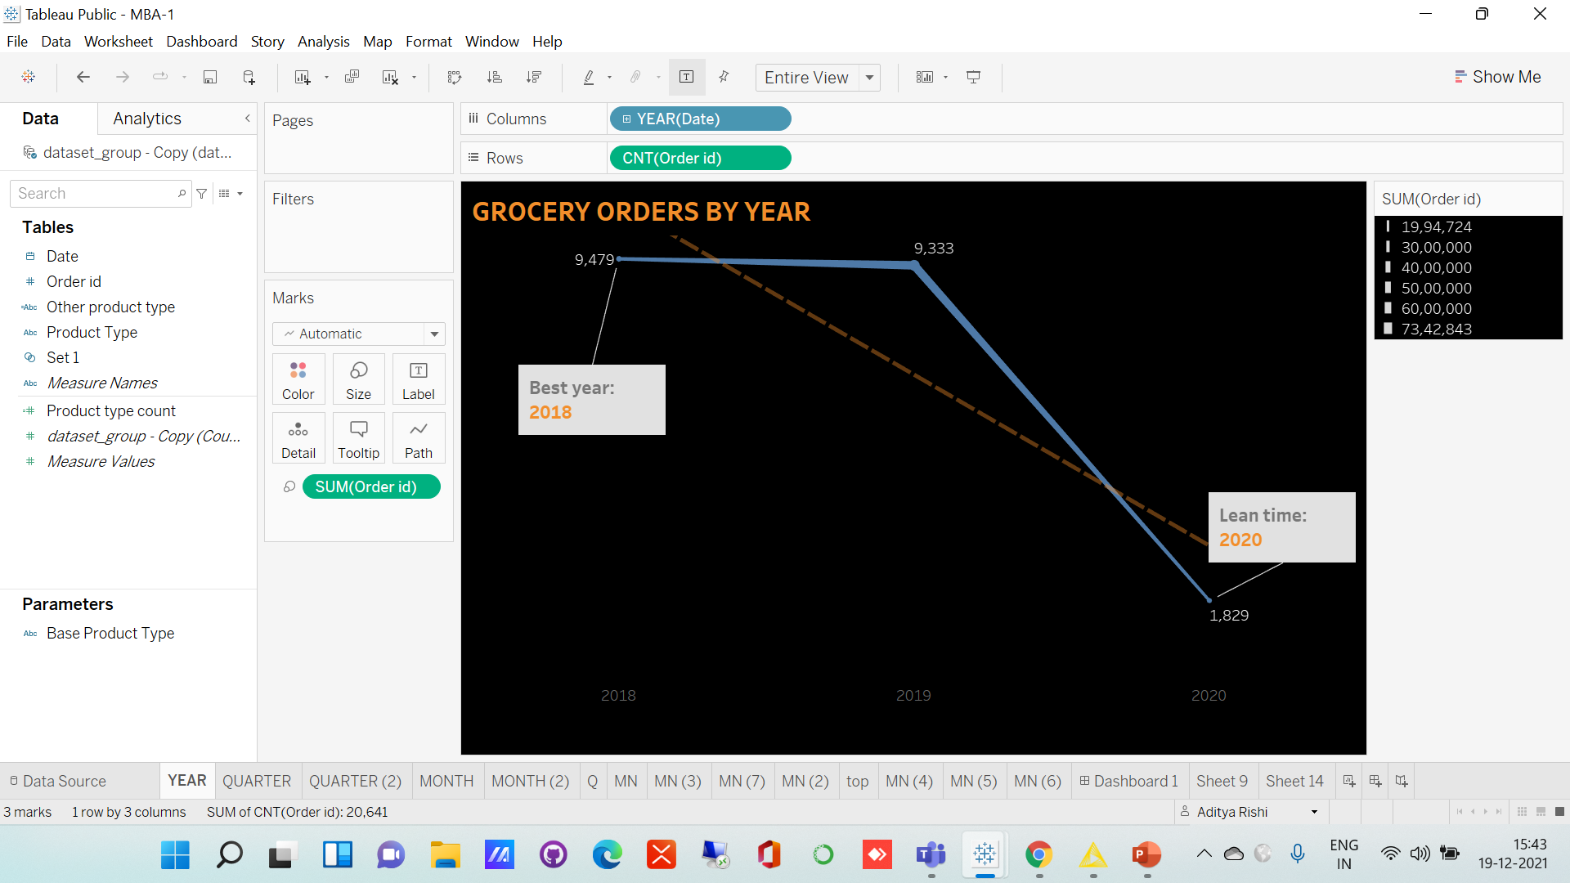
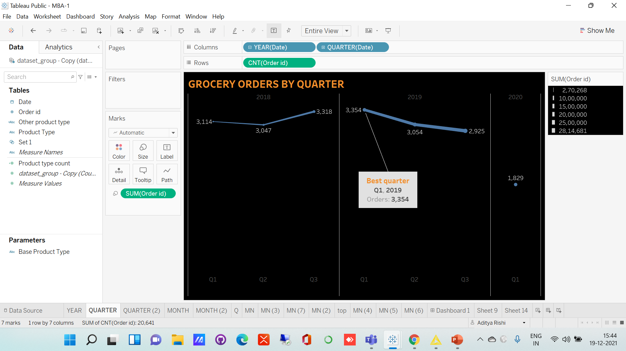
Best quarter
Marked
SEASONAL TRENDS
2020
Bad start

Slide 6
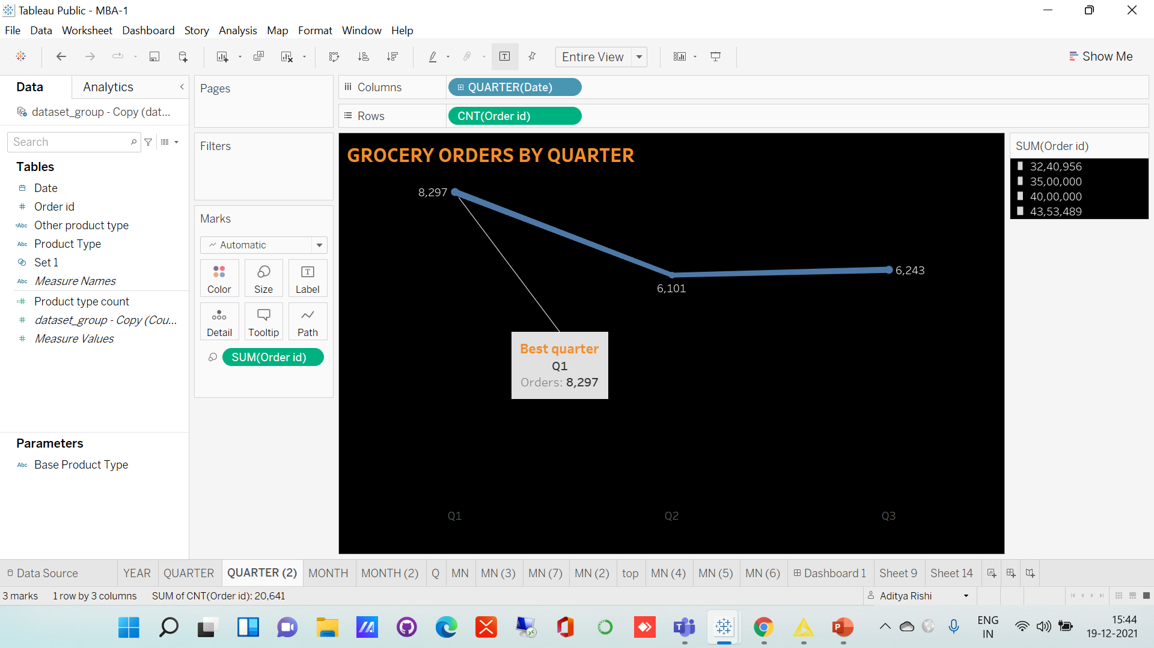
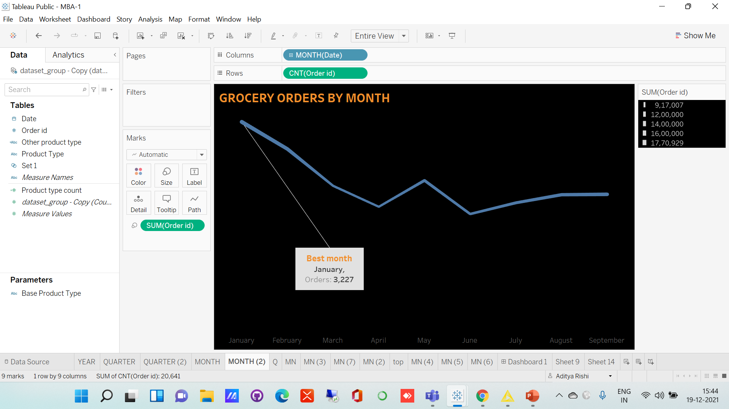
SEASONAL TRENDS

Slide 7
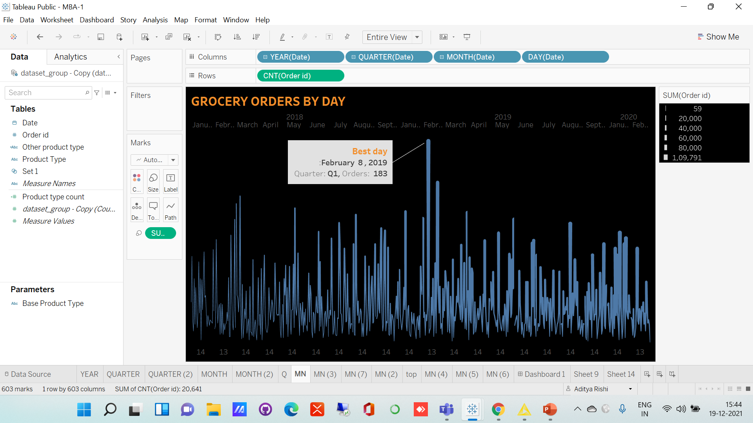
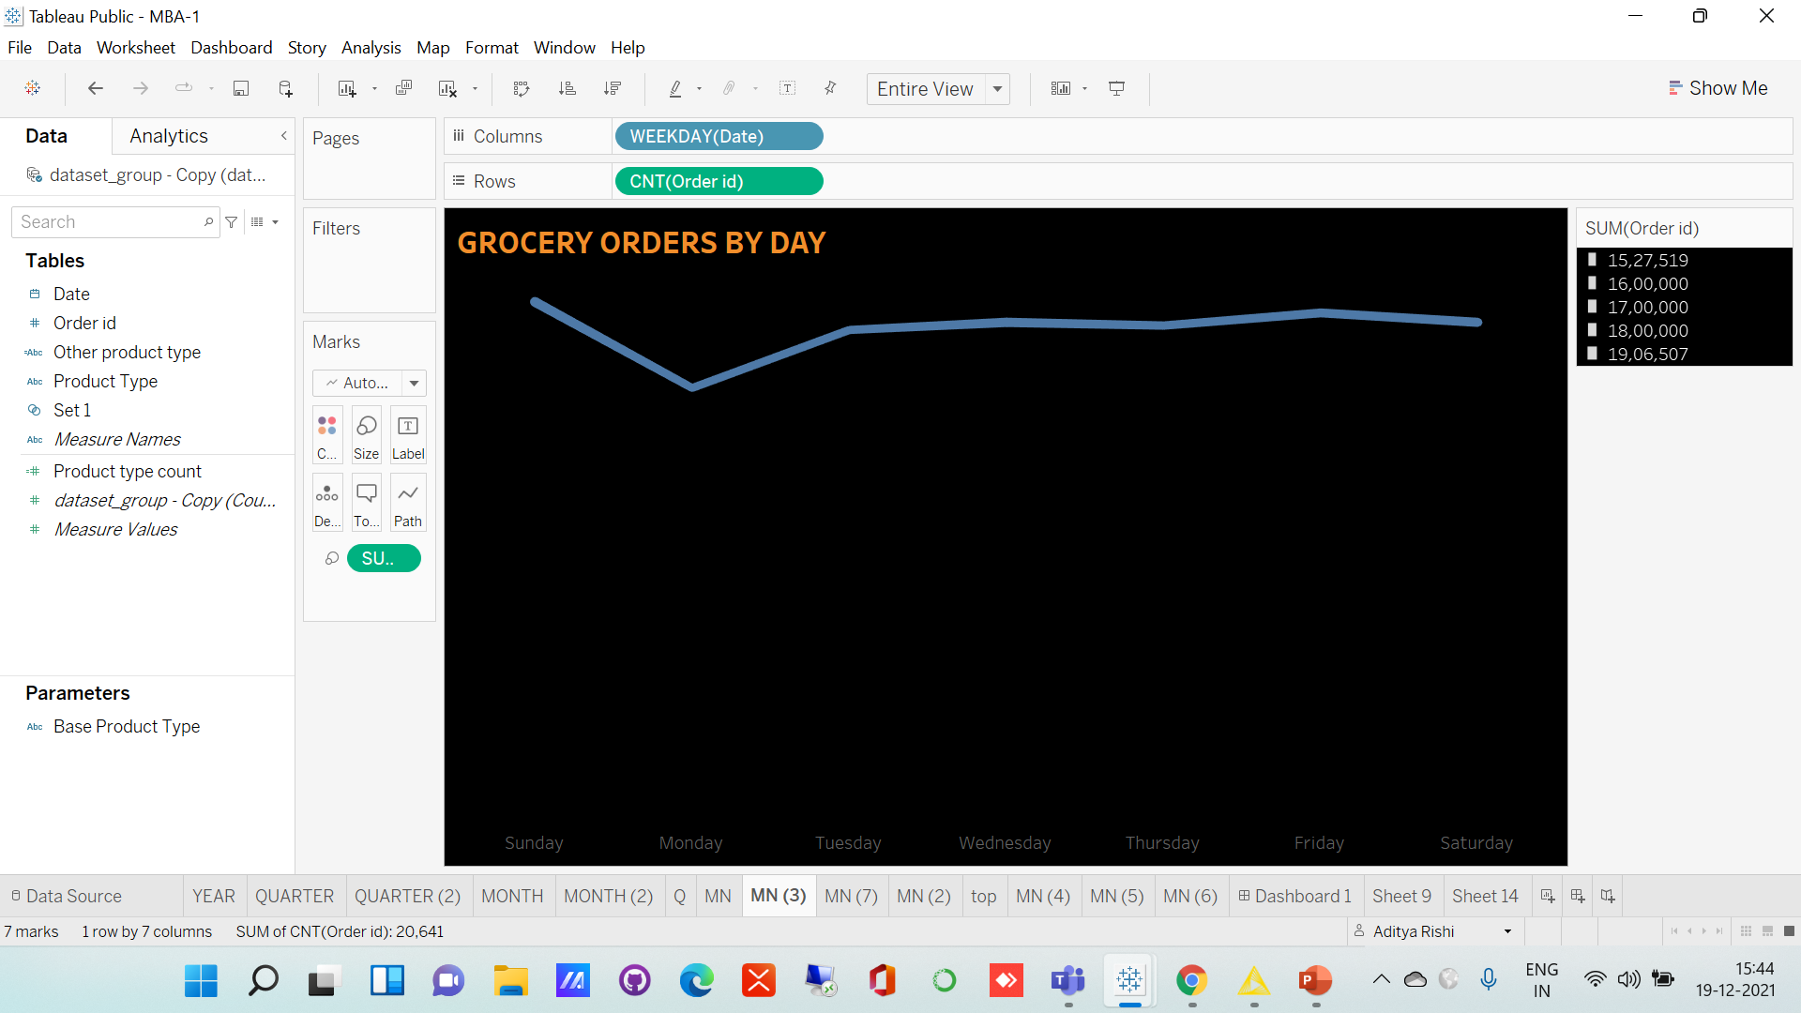
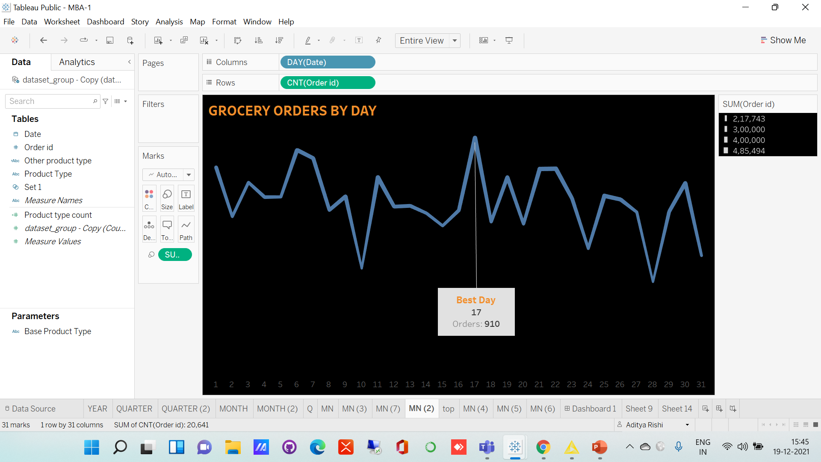
SEASONAL TRENDS

Slide 8
WHAT ARE ASSOCIATION RULES ?
01
Technique to identify underlying relationships between different items in a large dataset to reveal how seemingly unrelated items have associations among them.
02
It works by looking for combinations of items that occur together frequently in transactions. To put it another way, it allows retailers to identify relationships between the items that people buy.
03
Primarily used in retail industry to do Market Basket Analysis and recommendation systems for video and music streaming sites.
04
Association Rules are generally expressed in an ‘if-then’ format. We can also use the term ‘antecedent’ for if and ‘consequent’ for then.

Slide 9

01
Hidden Patterns
To find hidden patterns in customer purchase behaviours
Promotional Strategy
Association rules will help us to formulate a promotional strategy for the cafe chain.
02
WHY WE NEED ASSOCIATION RULES
Increase Revenue
With association rules, we can come up with combo offers and other promos which can maximize cafe's revenue.
03

Slide 10
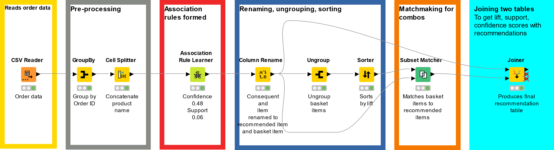
KNIME WORKFLOW

Slide 11
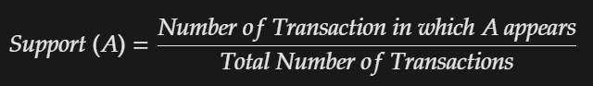
Definition
Support refers to items’ frequency of occurrence in the given data set.
SUPPORT THRESHOLD VALUES
Formula
Threshold Value
Higher the support, more frequently the items appears in the data set.
Keeping lower support threshold value, enables us to formulate more association rules

Slide 12
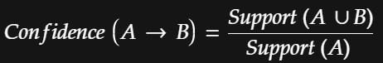
Definition
This says how likely item B is purchased when item A is purchased.
This is measured by the proportion of transactions with item A, in which item B also appears
CONFIDENCE THRESHOLD
VALUES
Formula
Threshold Value
Higher the confidence value, more often the rule is found to be true.
Keeping lower confidence threshold, enables us to formulate more association rules.

Slide 13
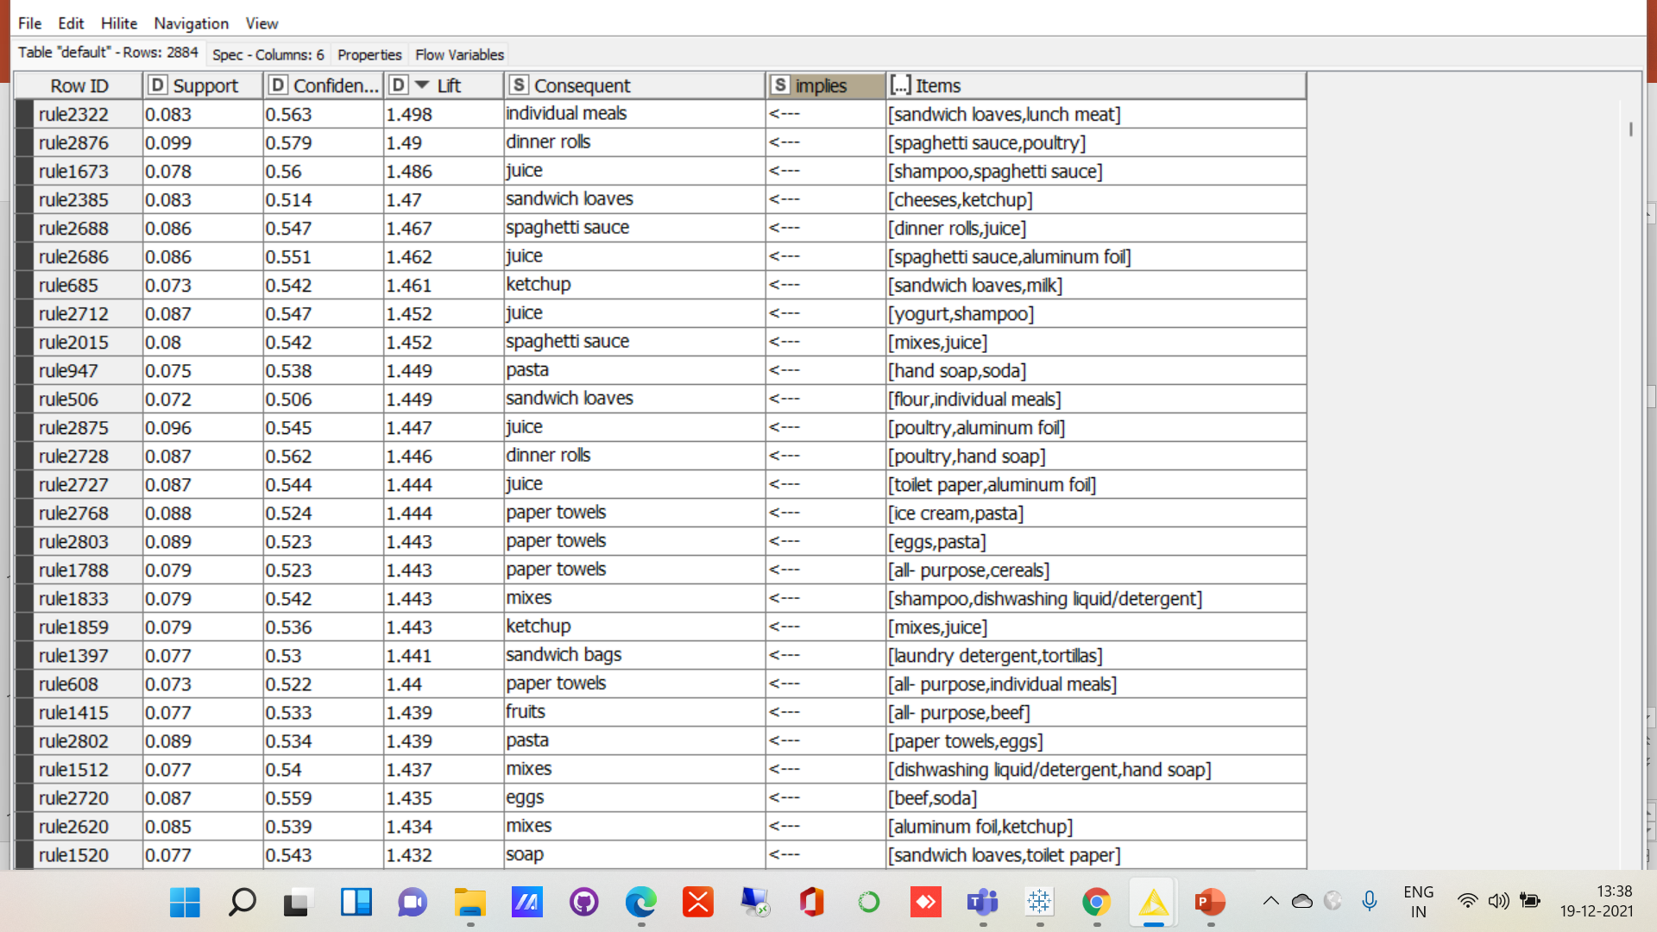
ASSOCIATIONS IDENTIFIED
FOOD ITEMS
RULES

Slide 14
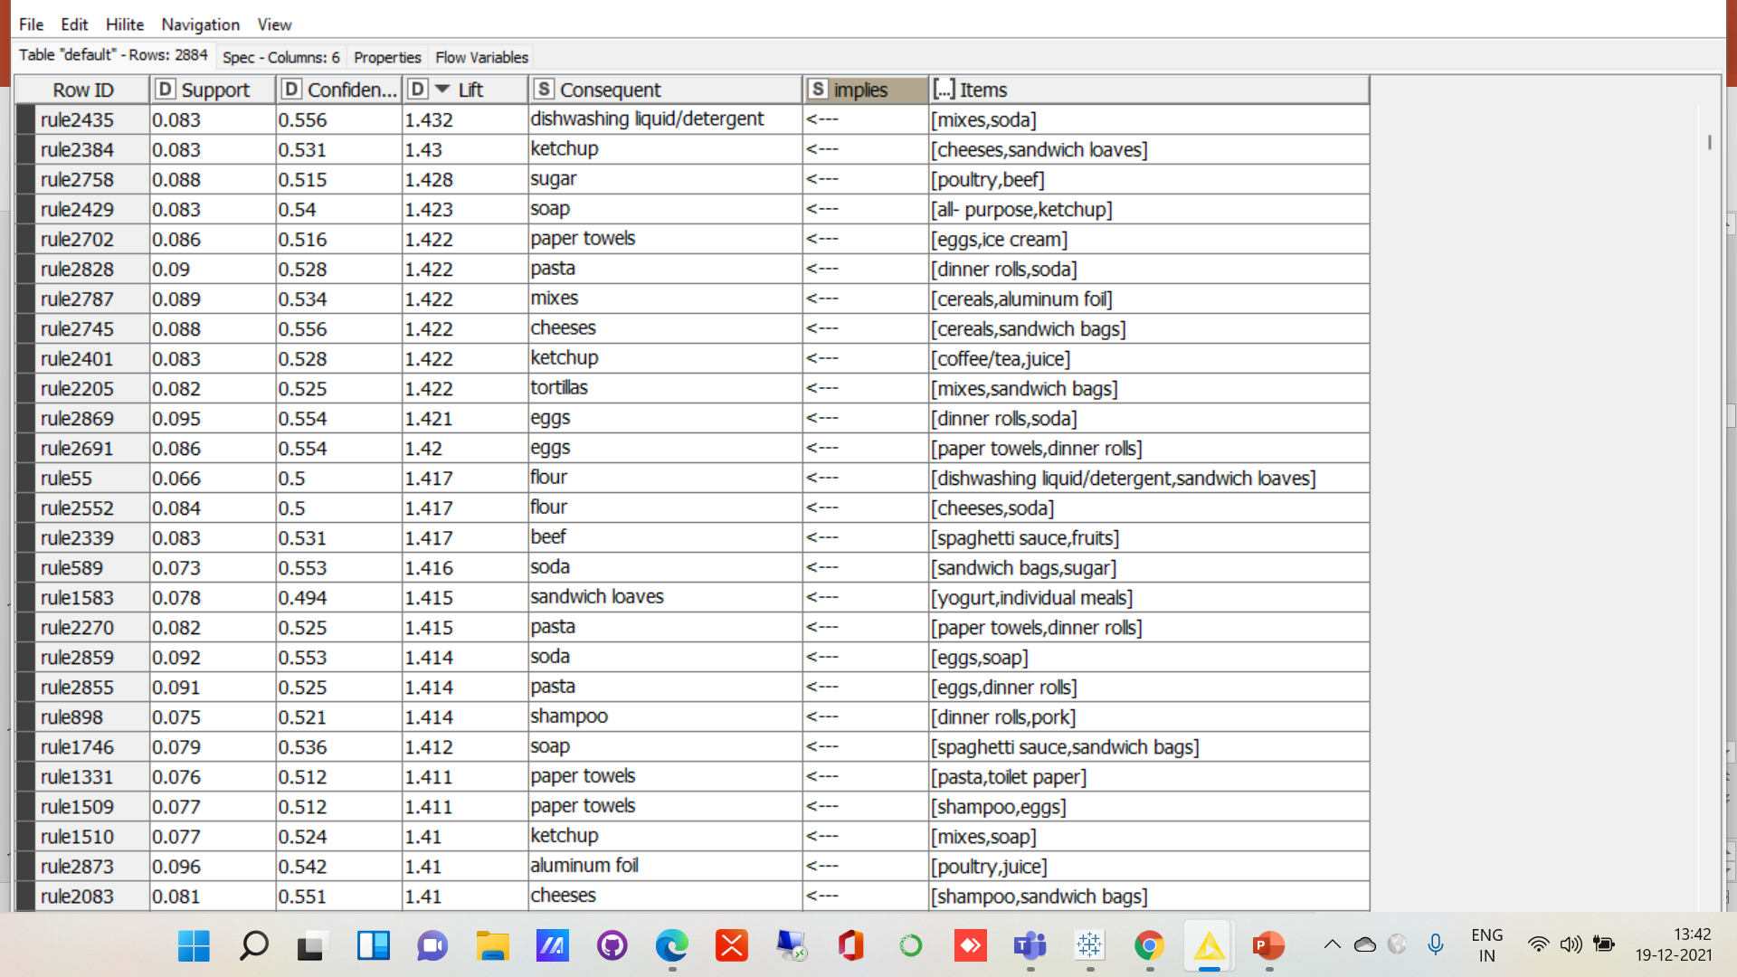
ASSOCIATIONS IDENTIFIED
FOOD ITEMS
RULES

Slide 15
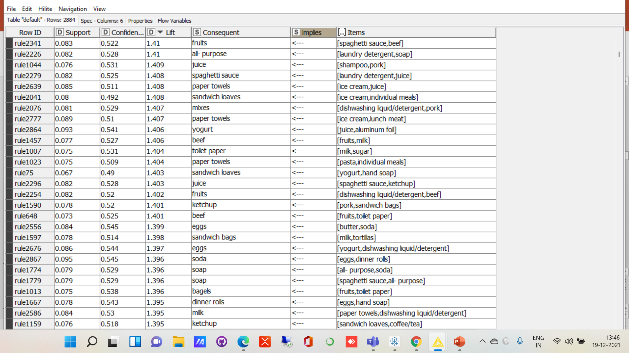
ASSOCIATIONS IDENTIFIED
FOOD ITEMS
RULES

Slide 16
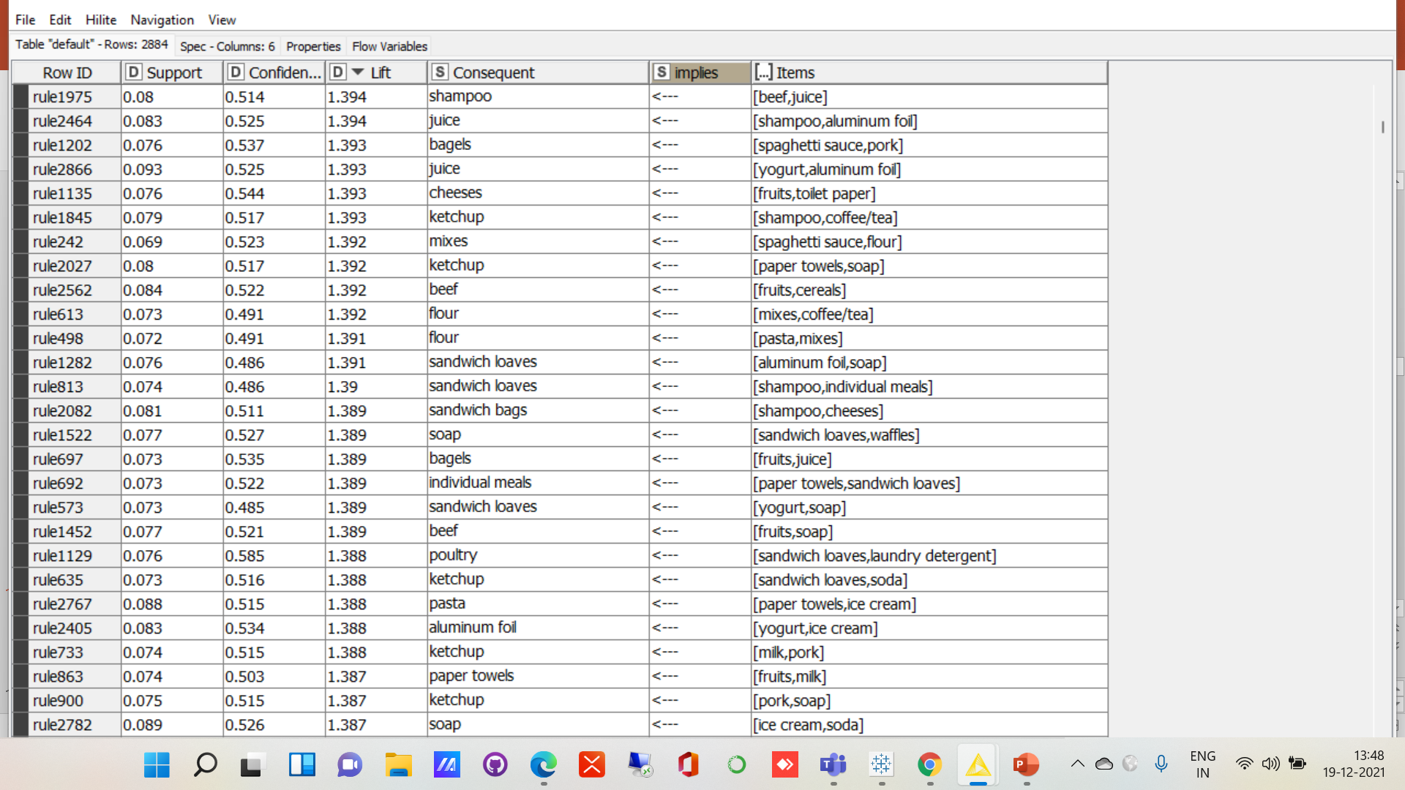
ASSOCIATIONS IDENTIFIED
FOOD ITEMS
RULES

Slide 17
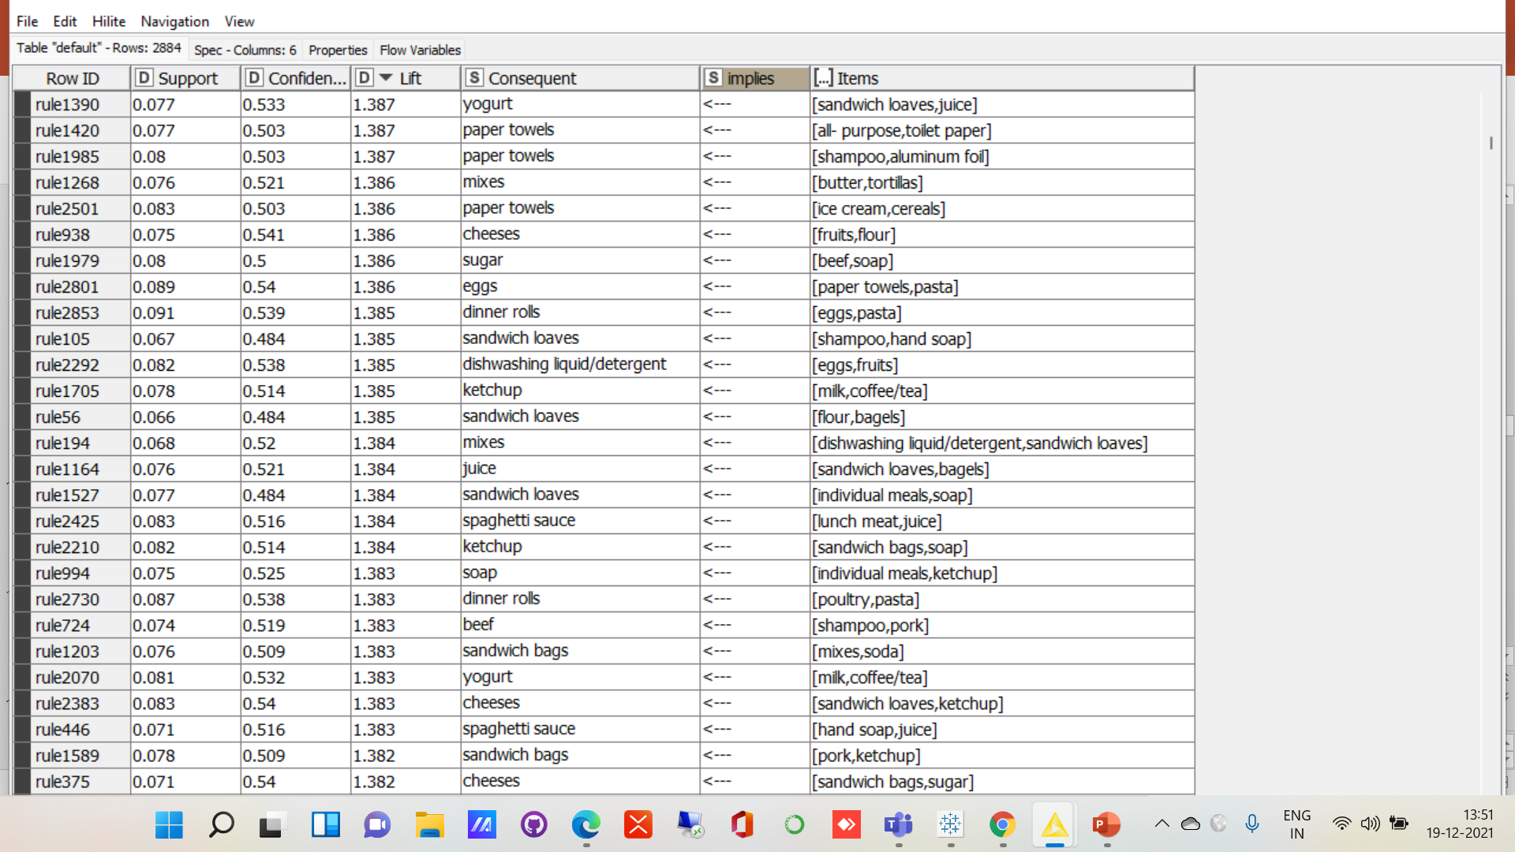
ASSOCIATIONS IDENTIFIED
FOOD ITEMS
RULES

Slide 18

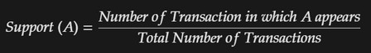
Support Values
FOOD ITEM RULES
Various values were tried for suport value.
Finally, for product rules, Support Value was set to 0.06
OPTIMIZE
This was done to optimize the number of association rules. Very low value gave too many records, while a very high value gave too less records.
COMBO
Higher value of support, led to only single products in the o/p. reducing the support value enabled multiple sets of items in basket. Enabling us to look for various combos.
CALCULATION
Support is calculated as the number of transaction in which A appears divided by Total Transactions.

Slide 19

Confidence Values
FOOD ITEM RULES
Various values were tried for confidence value.
Finally, for product rules, Confidence Value was set to 0.48
OPTIMIZE
This was done to optimize the number of association rules. Very low value gave too many records, while a very high value gave hardly any records.
COMBO
Higher value of confidence
, led to only single products in the o/p. reducing the confidence value enabled multiple sets of items in basket. Enabling us to look for various combos.
CALCULATION
Confidence of A implies B is calculated as Support of A union B divided by Support of A

Slide 20
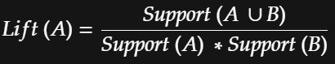
Lift Values
DEFINITION
This says how likely item B is purchased when item A is purchased, while controlling for how popular item B is.
VALUE
Lift value is auto calculated by the algorithm and we do not populate the value for this variable.
SORTING
Since lift calculates the effectiveness of the rule, we sorted the generated association rules using Lift. Higer the lift better the rule.
CALCULATION
Lift value is calculated by dividing "Support of A union B" with the "product of Support of A and Support of B"
The lift value is a measure of importance of a rule.

Slide 21
RECOMMENDATIONS

Slide 22

RECOMMENDATIONS
STAR CATEGORY
Given that POULTRY is the highest order generator, it makes sense to introduce combos and discount on this category.
DISCOUNT
Discount can be given on HAND SOAP AND SANDWICH LOAVES, as orders for those are low, at the bottom of the analysis charts.
COMBOS
Various Combo offers can be given looking at the Market basket analysis. Details for such combo offers have been covered later.
HAPPY HOURS
Happy hours offer can be given on Waffles, Yogurt, and Spaghetti sauce on Mondays when orders are low.

Slide 23
SANDWICH LOAVES, LUNCH MEAT
CHEESES AND KETCHUP |  | ICE-CREAM OR SANDWICH LOAVES
INDIVIDUAL MEALS
COMBO OFFERS
COMBO OFFERS SHOULD BE PROVIDED ON THESE FOOD ITEMS BROADLY
SPAGHETTI SAUCE, POULTRY |  | CHEESES OR DINNER ROLLS
EGGS OR SPAGHETTI SAUCE
DINNER ROLL, JUICE
Breads can be offered in combo with poultry or meals.
Food item can be offered at discount if customer orders at least 1 item from Beverage and another from bread. Beverage item can be offered at discount if customer orders at least 1 item from bread and meal.
Spaghetti sauce can be offered in combo with poultry, especially on Sunday when order numbers are high.

Slide 24
COMBO OFFERS
SPAGHETTI SAUCE, POULTRY | SOAP
CHEESE, KETCHUP |  | FLOUR
FLOUR, BAGELS |  | SANDWICH LOAVES
ALL- PURPOSE, TOILET PAPER |  | PAPER TOWELS
EGG, PASTA |  | DINNER ROLLS
MILK, COFFEE /TEA |  | KETCHUP
E
BUTTER TORTILLAS, MISES | M | MIXES
DINNER ROLLS, JUICE |  | YOGURT
DINNER ROLLS, JUICE |  | ALUMINIUM FOIL
COMBO OFFERS SHOULD BE PROVIDED ON THESE FOOD ITEMS
Various combo offer shown above can be provided to the customers. Item in the big square implies the item in the smaller square.

Slide 25
Buy 2 Get 1 Free
MILK & JUICE |  | YOGURT
EGGS, & INDIVIDUAL MEALS |  | POULTRY
SODA & JUICE |  | WAFFLES
E
EGGS & INDIVIDUAL MEALS |  | SODA
WAFFLES, & BEEF |  | ICE-CREAM
SOAD, & JUICE |  | EGGS
E
EGGS & INDIVIDUAL MEALS |  | ICE-CREAM
HAND SOAP & SOAP |  | SODA
WAFFFLES, & BEEF |  | FRUITS
BUY 2 GET 1 FREE OFFERS
Buy two get one free offer can be given on above items.
For instance, buy EGGS & INDIVIDUAL MEALSand get 1 ICE-CREAM free. Since these items are often bought together BUT ORDERS are not as good as some of the other items
Item in the big square implies the item in the smaller square.

Slide 26
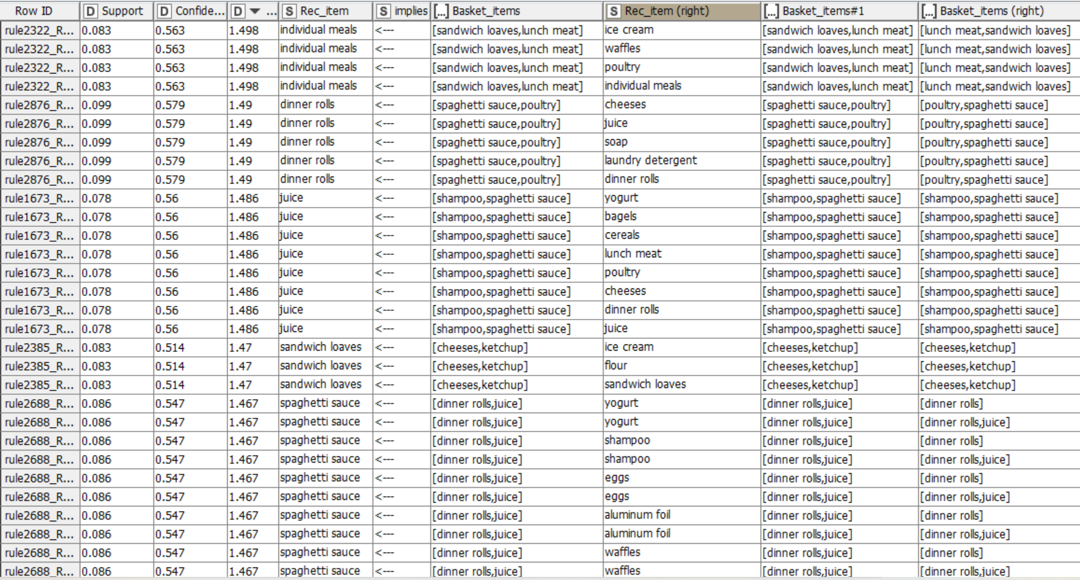
RECOMMENDATIONS

Slide 27
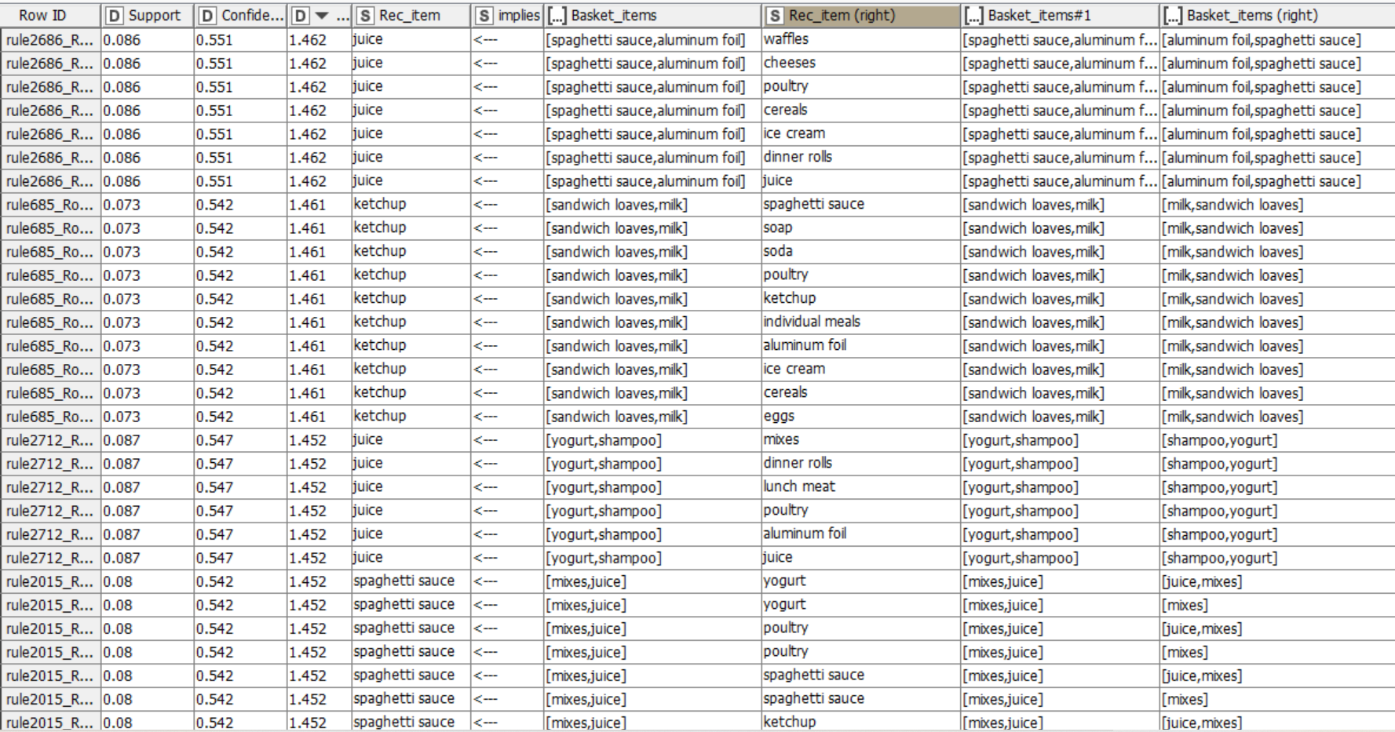
RECOMMENDATIONS

Slide 28
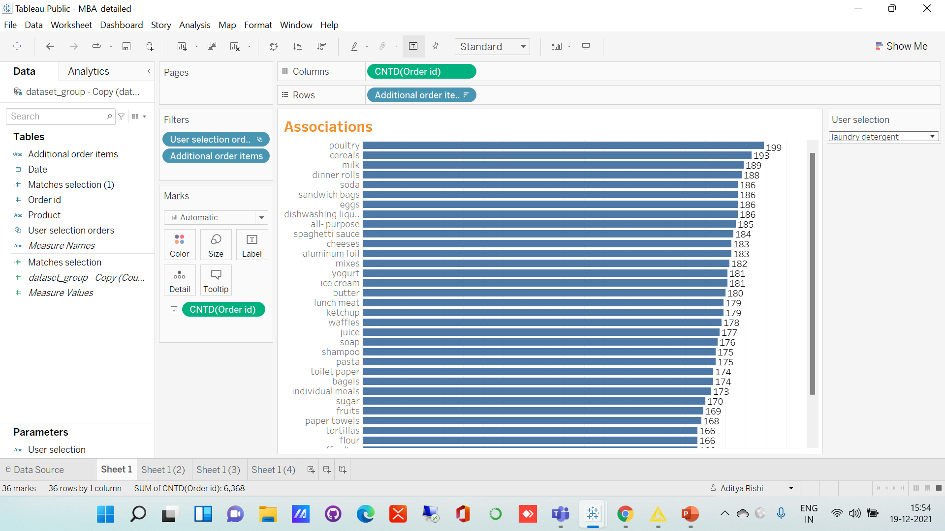
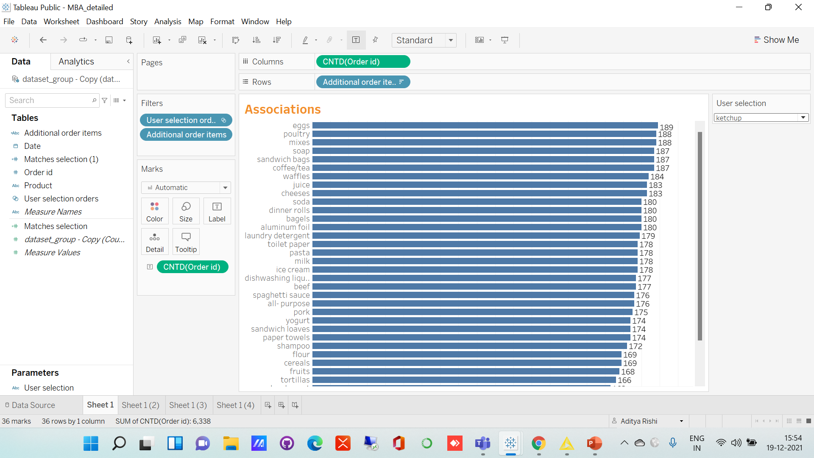
ASSOCIATIONS TO SUGGEST
Customers who bought laundry detergent
Also ordered poultry 199 times
Customers who bought ketchup
Also ordered eggs 189 times

Slide 29
COMBO OFFERS
Combo offers listed above can be offered, as one items implies the other item will be bought. Offering the combo will further boost the chances of sale.
BUY 2 GET 1 FREE
Buy 2 get 1 free offers are a good way to promote sales of multiple items which when bought together imply the sales of a third item. This will maximize the revenue across various categories of items.
OFFERS
DISCOUNT
Discount can be offered on items which do not make it to the list of items in the association rules, since the sales of such items is low and a discount can help boost sales.

Slide 30

THANK YOU!!
2 Tableau file links
Tools used
KNIME AND TABLEAU

